Slide 1


Slide 2


Moving corporate user data to OneDrive for Business: How hard can it be?
Raymond P.L. Comvalius - MVP
IT Infrastructure Architect/Trainer
@nextxpert

Slide 3
Agenda
The Business Case
Definition of the Project
Migration of the Data
Migration of the Client
Lessons Learned

Slide 4

The Business Case
OneDrive storage is included with Office 365
Let’s get started with the Standard Solution….

Slide 5
Starting Point
Personal shared folders on SMB file server
Users did not use OneDrive for Business
Users were not yet licensed for OD4B or SharePoint Online
Users run on Windows Clients

Slide 6
Migration Strategy
License
Referrals
OneDrive Sync Client
Data

Slide 7
Projected End State
OneDrive contents resemble Home Folder
Home Folder is removed
Known Folders refer to OneDrive
No more referrals to the file share

Slide 8
Defining the migration strategy
A Microsoft solution is preferred
Some users have a lot of data
Multiple batches of users to migrate

Slide 9
Migrating the Data

Slide 10

Known Folder Move (now named PC folder backup)
User Migration for 3 Known Folders:
Desktop
Documents
Pictures
Not supported with Folder Redirection
+OneNote
Notes:
Share as a source location since November 2019
Default folder names/locations required
OneNote Migration

Slide 11

SharePoint and OneDrive Migration Tool (SPMT)
Scalability
Flexibility
Scheduling support
Workflow Support
Service Account support
Handling of illegal file names
OneDrive Provisioning

Slide 12
Sync and cutover process
Validation
Exists in Office 365
Source & Target address exists
OneDrive user exists
Synchronization
Initial Sync
Delta Sync
Cutover
Migration to OneDrive
Licensed

Slide 13
Moving the Data
3rd party tool instead of the SharePoint Migration Tool (SPMT)
Authorization of the service account
Backup Privilege to the rescue?
Throttling by Microsoft
>100 TB to migrate: contact Microsoft

Slide 14
File and Folder Referrals

Slide 15
Moving Client-side Referrals
Redirected folders
Recent Files and folders (MRU)
User Generated Links
Notes:
+ User Defined links

Slide 16
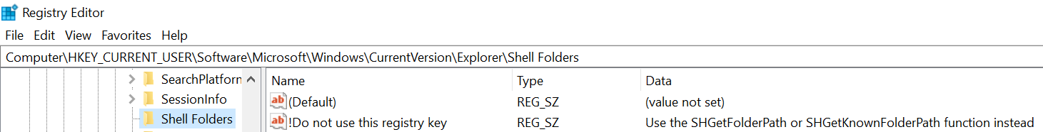
Folder Redirection
Alternative Folder Redirection config
Folder Redirection is OLD technology
Not just registry settings
No GPO = No Automatic Offline Files

Slide 17
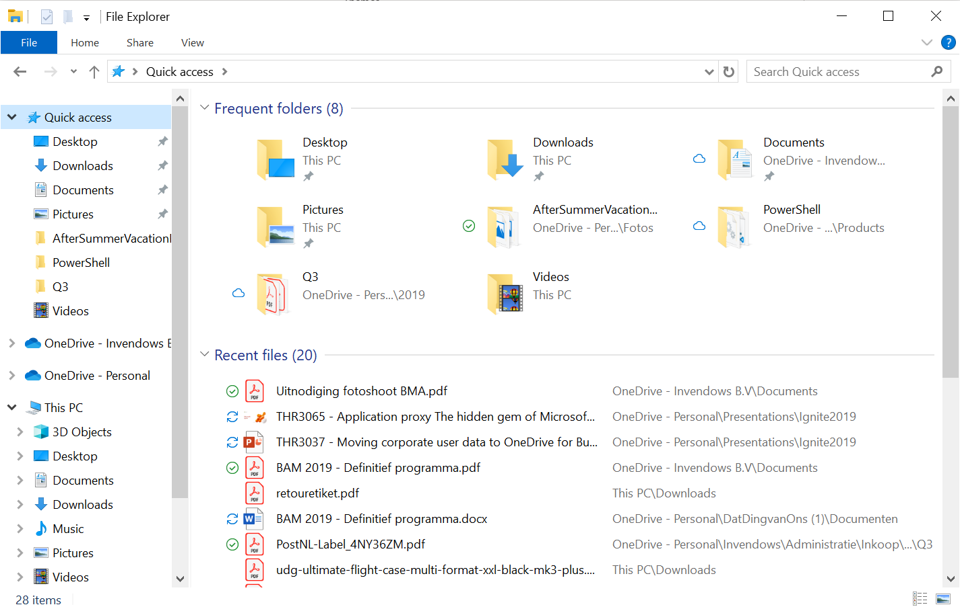
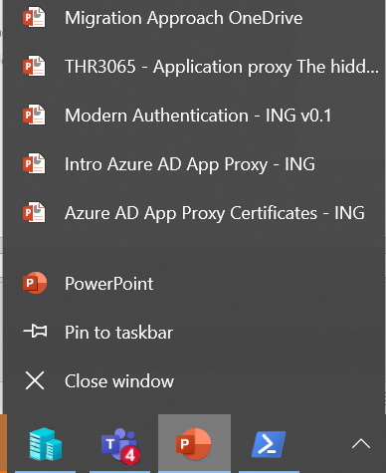
Recent Files and Folders (MRU)
Multiple places in Windows 10
Quick Access Folders
Recent Files
Office Recent Files
Notes:
3 recent locations:
%userProfile%\recent
%AppData%\Microsoft\Windows\Recent Items
%appdata%\Microsoft\Office\recent
Jumplists in compound files can only be deleted
MRU in registry can be edited
Lnk-files in other locations (ie desktop and Start Menu)

Slide 18
Rewriting pinned Quick Access items
$PinnedItems = @()
$Namespace = "shell:::{679f85cb-0220-4080-b29b-5540cc05aab6}"
$QuickAccess = New-Object -ComObject shell.application
$QAItems = $QuickAccess.Namespace($Namespace).Items()
$QAItems| ForEach-Object{
if ($_.verbs() | Where-Object Name -Match "Unpin from Quick access"){
$PinnedItems += $_
}
}
$PinnedItems | ForEach-Object{
$NewPath = $_.Path.replace($OldPath,$NewPath)
$_.InvokeVerb("unpinfromhome")
$QuickAccess.Namespace($NewPath).Self.InvokeVerb("pintohome")
}

Slide 19
Cleanup Quick Access with PowerShell
$Namespace = "shell:::{679f85cb-0220-4080-b29b-5540cc05aab6}"
$QuickAccess = New-Object -ComObject shell.application
$QAItems = $QuickAccess.Namespace($Namespace).Items()
$FilteredItems = $QAItems |’
Where-Object {($_.Path -like "$OldPath*")}
$FilteredItems | ForEach-Object {$_.InvokeVerb("remove")}

Slide 20
Rewrite shortcuts with PowerShell
$obj = New-Object -ComObject WScript.Shell
$link = $obj.CreateShortcut($lnkFile)
$link.TargetPath = $link.TargetPath.replace($OldPath, $NewPath) $link.Save()
%UserProfile%\Recent
%AppData%\Microsoft\Windows\Recent Items
%AppData%\Microsoft\Office\Recent

Slide 21

OneDrive Sync Client https://onedrive.uservoice.com/

Slide 22

OneDrive Sync Client
Default install location: %localappdata%\Microsoft\OneDrive
New: Machine based install
%ProgramFiles(x86)%\Microsoft OneDrive
Autostart from registry Run-key
Notes:
https://onedrive.uservoice.com/forums/913522-onedrive-on-windows

Slide 23
OneDrive Sync Client (OneDrive.exe)
Management
Updating
Integration Features
Notes:
Is OneDrive part of Windows or part of Office?

Slide 24
Managing the OneDrive Client
ADMX must be updated with new client versions – not with Windows
Currently 31 settings in Group Policy for OneDrive
Missing settings:
Hide OneDrive Personal
Include/exclude files to sync
Disable OneDrive per user
Notes:
https://onedrive.uservoice.com/forums/262982-onedrive-archive/suggestions/32183158-ability-to-mandatorily-sync-certain-folders-to-one
https://onedrive.uservoice.com/forums/913522-onedrive-on-windows/suggestions/10160991-i-want-to-hide-onedrive-in-explorer-it-is-so-anno
https://onedrive.uservoice.com/forums/913522-onedrive-on-windows/suggestions/18449926-reassess-the-possibility-to-ignore-or-exclude-sele

Slide 25

OneDrive Client Update
Enterprise/Production/Insider Rings
Not integrated with Windows Update
OneDrive Standalone Update Task in Task Scheduler
OneDriveStandAloneUpdater.exe
Daily task
Notes:
https://onedrive.uservoice.com/forums/913522-onedrive-on-windows/suggestions/33310621-onedrive-ngsc-update-via-windows-update

Slide 26

OneDrive Sync Client Integration in Windows
Eventlogs
text logs
script integration
Notes:
Get-ODStatus from OneDriveLib.dll is broken since the introduction of Files-on-Demand
https://onedrive.uservoice.com/forums/913522-onedrive-on-windows/suggestions/35069281-action-change-logging-in-evenlog
https://onedrive.uservoice.com/forums/913522-onedrive-on-windows/suggestions/7855332-api-for-onedrive-for-business-sync-client

Slide 27
Other Features
Known Folder Move or PC Folder Backup
Files on Demand
Windows 10 1709 or newer
Windows Server 2019 or newer
Machine based install is the new recommendation
Starting with OneDrive client version 19.174.0902.0013

Slide 28
OneDrive Client Challenges
Just in time Enabling OneDrive Client
Hide OneDrive Personal
OneDrive client status
Updating ADMX Templates

Slide 29
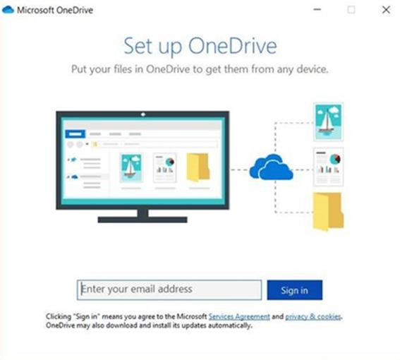
Enabling OneDrive Sync Client
Computer Policy to disable OneDrive Sync Client
Prompts when not configured/licensed
Software Restriction Policies to the rescue
Disallow execution for non-migrated users
Notes:
https://onedrive.uservoice.com/forums/913522-onedrive-on-windows/suggestions/18402466-option-to-disable-the-daily-set-up-onedrive-noti

Slide 30
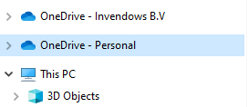
Hiding OneDrive Personal
Group Policy Setting to disable OneDrive Personal
Group Policy does not hide the OneDrive Personal Folder
Use the following Registry Key to hide OneDrive Personal
HKCU:\Software\Classes\CLSID\{018D5C66-4533-4307-9B53-224DE2ED1FE6}
Name System.IsPinnedToNameSpaceTree
Value 0
Notes:
https://onedrive.uservoice.com/forums/913522-onedrive-on-windows/suggestions/10160991-i-want-to-hide-onedrive-in-explorer-it-is-so-anno

Slide 31

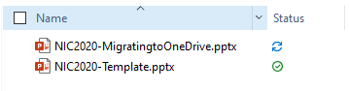
OneDrive Sync Client Status
No warning when OneDrive.exe does not start
User can notice two things:
Cloud icon in the Task bar
File/Folder Status icons in Windows Explorer
No status in Event Logs
Notes:
https://onedrive.uservoice.com/forums/913522-onedrive-on-windows/suggestions/33483997-onedrive-syncronization-detailed-status
https://onedrive.uservoice.com/forums/913522-onedrive-on-windows/suggestions/36123916-admin-report-of-one-drive-status-across-a-network

Slide 32
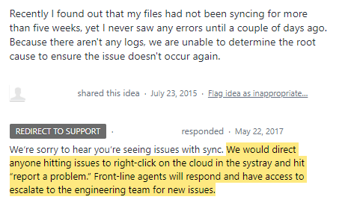
OneDrive Client does not log events
Here’s Microsoft official response (voting disabled):
https://onedrive.uservoice.com/forums/262982-onedrive-archive/suggestions/8993923-onedrive-event-log

Slide 33

Migrating OneNote
New feature of KFM since February 2020
Different store format on OneDrive
OneNote does the transformation
C# source available for bulk migration
https://github.com/msftjayongg/MigrateSample

Slide 34
Summary
License
Referrals
OneDrive Sync Client
Data

Slide 35
Slides and demos from the conference will be available at
https://github.com/nordicinfrastructureconference/2020

